Slide 1
MA3077 (DLI) Operational Research Lecture 14 – Stable games and saddle points
Dr Marco Fasondini

Slide 2
Recapitulation and lecture outline
Recap: in the previous lecture we introduced 2-person zero-sum games and learnt
pay-off matrix reduction by dominated strategies,
what minimax and maximin strategies are
and that saddle-points characterise stable solutions
Today: We prove the tight relationship between stable games and saddle points (following closely Ch. 15 of the book by Hillier and Lieberman).

Slide 3
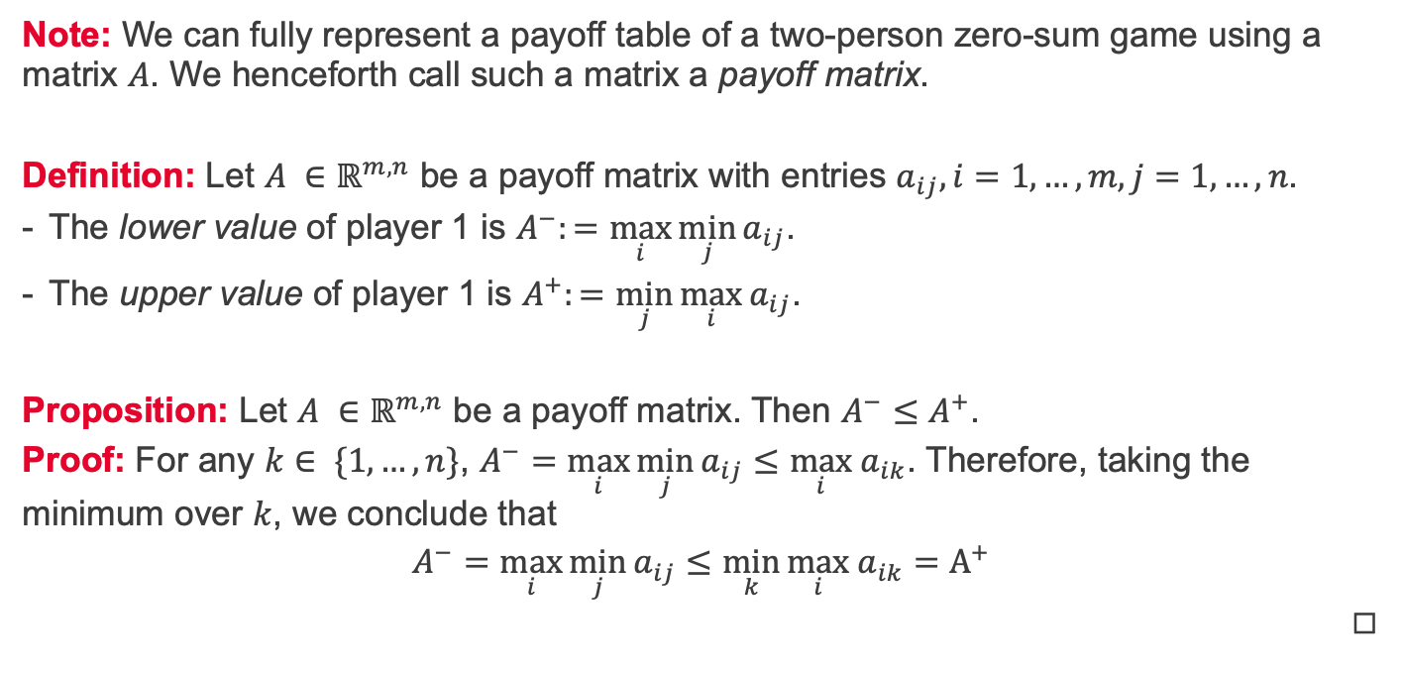
Lower and upper values of a game
Note: We can fully represent a payoff table of a two-person zero-sum game using a matrix $A$. We henceforth call such a matrix a payoff matrix.
Definition: Let $A ∈ℝ^{m,n}$ be a payoff matrix with entries $a_{ij}, i=1,…,m, j=1, …, n$.
The lower value of player 1 is $A^{−}:=\max_{i}{\min_{j}{a_{ij}}}$.
The upper value of player 1 is $A^{+}:=\min_{j}{\max_{i}{a_{ij}}}$.
Proposition: Let $A ∈ℝ^{m,n}$ be a payoff matrix. Then $A^{−}≤A^{+}$.
Proof: For any $k∈ \{1,…,n\}$, $A^{−}=\max_{i}{\min_{j}{a_{ij}}}≤\max_{i} a_{ik}$. Therefore, taking the minimum over $k$, we conclude that
$$A^{−}=\max_{i}{\min_{j}{a_{ij}}}≤\min_{k}{\max_{i} a_{ik}}=A^{+}$$
◻︎

Slide 4

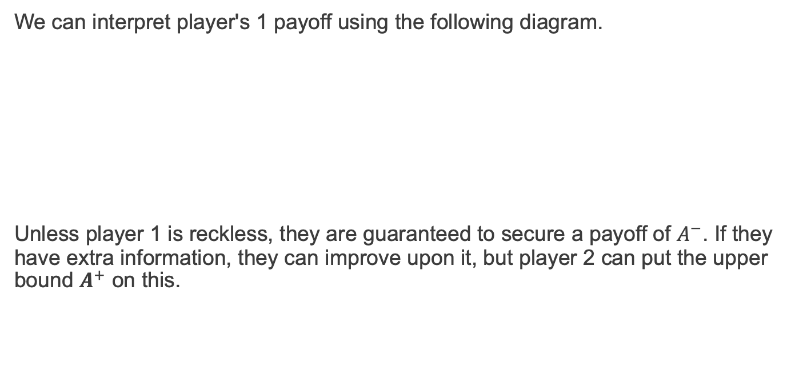

Interpretation of upper and lower values
We can interpret player's 1 payoff using the following diagram.
Unless player 1 is reckless, they are guaranteed to secure a payoff of $A^{−}$. If they have extra information, they can improve upon it, but player 2 can put the upper bound $A^{+}$ on this.
$$A^{−}$$
$$A^{+}$$
by intellect
by information
With help of opponent

Slide 5
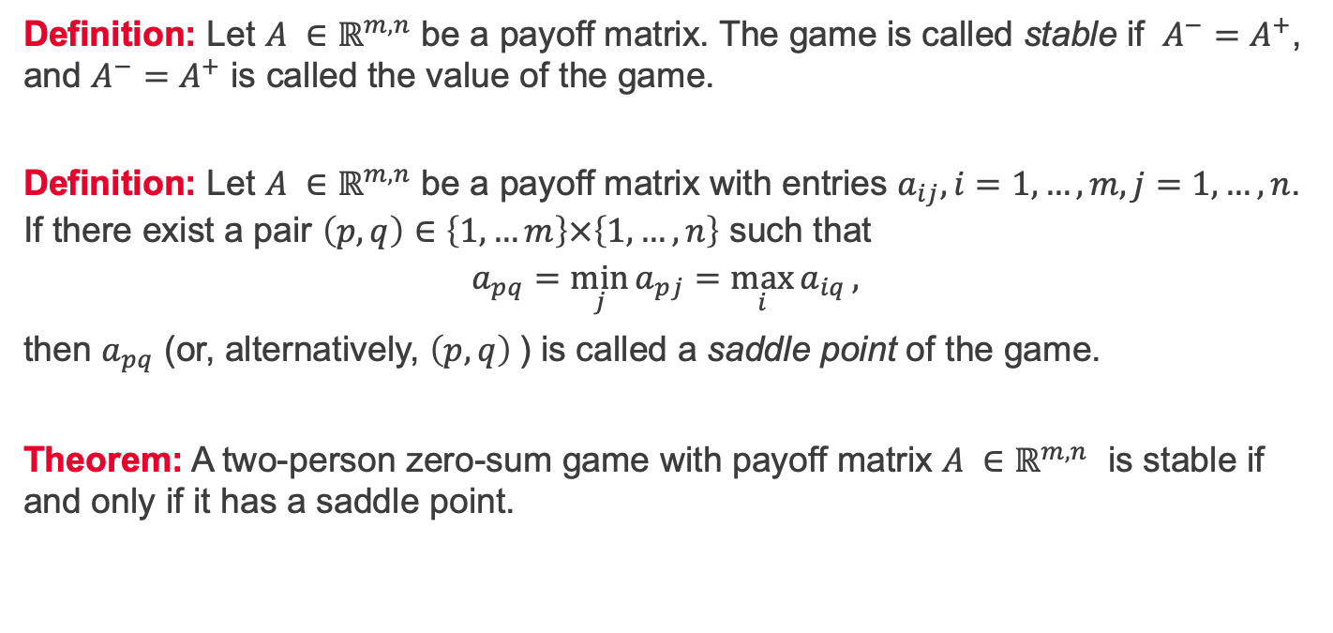
Stable games and saddle points
Definition: Let $A ∈ℝ^{m,n}$ be a payoff matrix. The game is called stable if $A^{−}=A^{+}$, and $A^{−}=A^{+}$ is called the value of the game.
Definition: Let $A ∈ℝ^{m,n}$ be a payoff matrix with entries $a_{ij}, i=1,…,m, j=1, …, n$. If there exist a pair $\left(p,q\right)∈\left\{1,…m\right\}×\left\{1,…,n\right\}$ such that
$$a_{pq}=\min_{j}{a_{pj}}=\max_{i}{a_{iq}},$$
then $a_{pq}$ (or, alternatively, $\left(p,q\right)$) is called a saddle point of the game.
Theorem: A two-person zero-sum game with payoff matrix $A ∈ℝ^{m,n}$ is stable if and only if it has a saddle point.

Slide 6
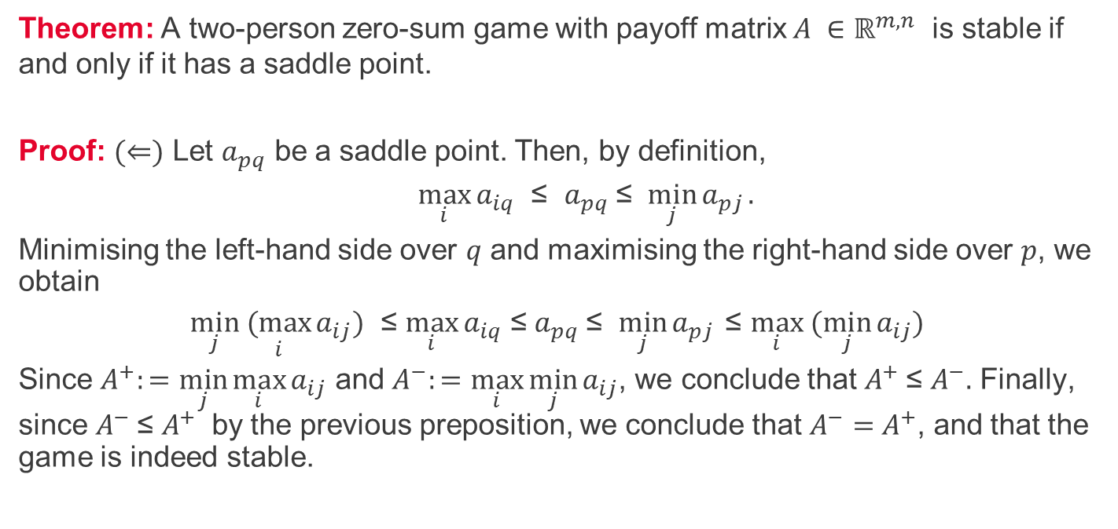
Stable games and saddle points $(⇐)$
Theorem: A two-person zero-sum game with payoff matrix $A ∈ℝ^{m,n}$ is stable if and only if it has a saddle point.
Proof: $(⇐)$ Let $a_{pq}$ be a saddle point. Then, by definition,
$\max_{i}{a_{iq}}$ ≤ $a_{pq} \text{≤ }$ $\min_{j}{a_{pj}}.$
Minimising the left-hand side over $q$ and maximising the right-hand side over $p$, we obtain
$\min_{j} \underset{i}{(max}{a_{ij}})$ ≤ $\max_{i}{a_{iq}}$ ≤ $a_{pq} \text{≤ }$ $\min_{j}{a_{pj}} \text{≤ }\max_{i} (\min_{j}{a_{ij})}$
Since $A^{+}:=\min_{j}{\max_{i}{a_{ij}}}$ and $A^{−}:=\max_{i}{\min_{j}{a_{ij}}}$, we conclude that $A^{+}$≤ $A^{−}.$ Finally, since $A^{−}$≤ $A^{+}$ by the previous preposition, we conclude that$A^{−}=$ $A^{+}$, and that the game is indeed stable.

Slide 7
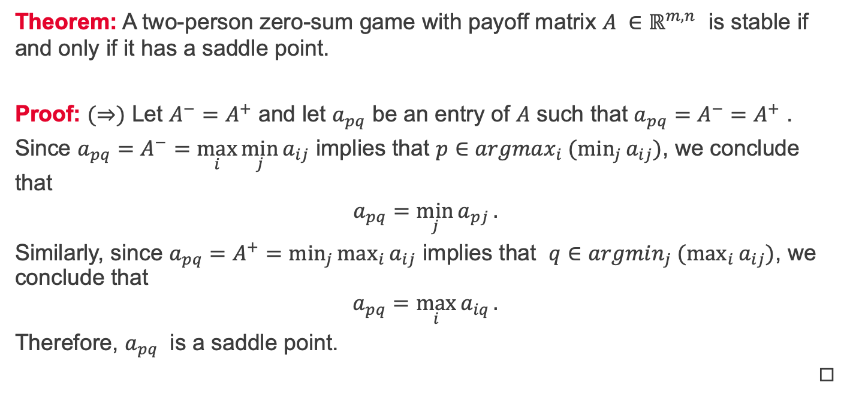
Stable games and saddle points $(⇒)$
Theorem: A two-person zero-sum game with payoff matrix $A ∈ℝ^{m,n}$ is stable if and only if it has a saddle point.
Proof: $(⇒)$ Let $A^{−}=$ $A^{+}$ and let $a_{pq}$ be an entry of $A$ such that $a_{pq}=$ $A^{−}=$ $A^{+}$ .
Since $a_{pq}=$ $A^{−}=\max_{i}{\min_{j}{a_{ij}}}$ implies that $p∈argmax_{i} (\min_{j}{a_{ij}})$, we conclude that
$$a_{pq}=\min_{j}{a_{pj}}.$$
Similarly, since $a_{pq}=$ $A^{+}=\min_{j}{\max_{i}{a_{ij}}}$ implies that $q∈argmin_{j} (\max_{i}{a_{ij}})$, we conclude that $$a_{pq}=\max_{i}{a_{iq}}.$$
Therefore, $a_{pq}$ is a saddle point.
◻︎

Slide 8
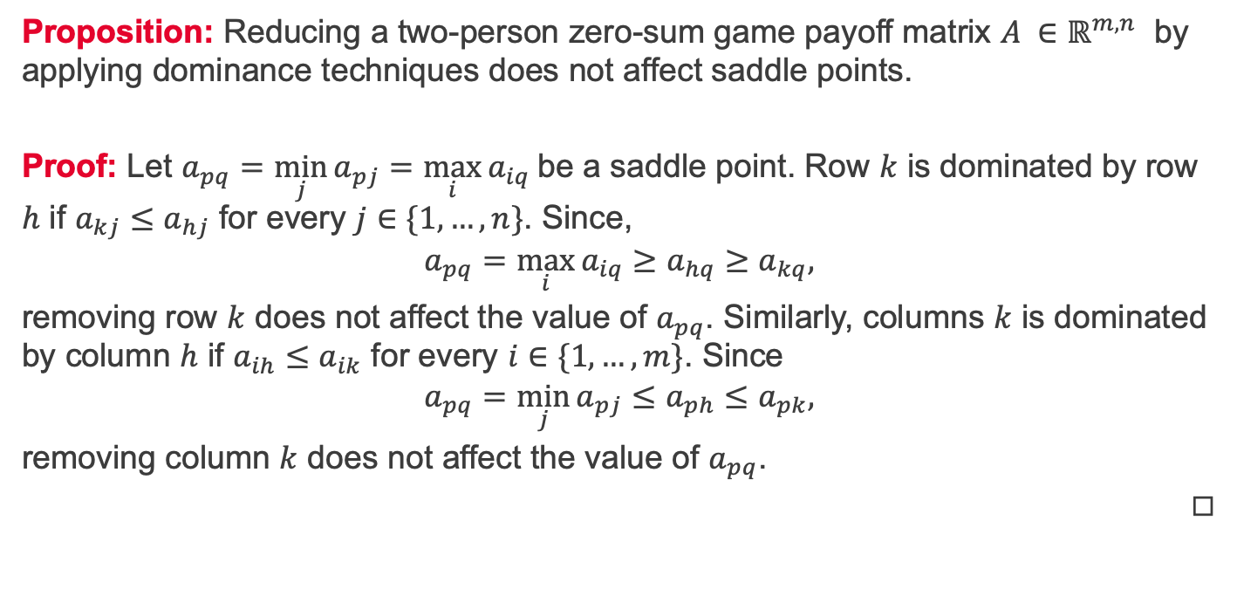
Reduction by dominance and saddle points
Proposition: Reducing a two-person zero-sum game payoff matrix $A ∈ℝ^{m,n}$ by applying dominance techniques does not affect saddle points.
Proof: Let $a_{pq}=\min_{j}{a_{pj}}=\max_{i}{a_{iq}}$be a saddle point. Row $k$ is dominated by row $h$ if $a_{kj}≤a_{hj}$ for every $j∈\{1,…,n\}$. Since,
$$a_{pq}=\max_{i}{a_{iq}}≥a_{hq}≥a_{kq},$$
removing row $k$ does not affect the value of $a_{pq}$. Similarly, columns $k$ is dominated by column $h$ if $a_{ih}≤a_{ik}$ for every $i∈\{1,…,m\}$. Since
$$a_{pq}=\min_{j}{a_{pj}}≤a_{ph}≤a_{pk},$$
removing column $k$ does not affect the value of $a_{pq}$.
◻︎

Slide 9

Not every game is stable
Consider the following scenario.
We observe that $A^{−}=−2<2=A^{+}$, therefore this game is not stable. Indeed, if player 1 chooses strategy 1, then player 2 chooses strategy 2, but then player 1 switches to strategy 2, in which case player 2 selects strategy 3, in which case player 1 applies strategy 1, and so forth...
Abstract game |  | Player 2 |  |  | Min
 | Strategy | 1 | 2 | 3 | Min
Player 1 | 1 | 0 | -2 | 2 | -2
 | 2 | 5 | 4 | -3 | -3
 | 3 | 2 | 3 | -4 | -4
Max | Max | 5 | 4 | 2

Slide 10
Summary and self-study
Summary: in this lecture and the previous lecture we have learnt:
about two-person zero-sum games,
how to apply reduction by dominance,
how to determine if a game is stable,
the reduction by dominance does not affect stability,
and that not all games are stable.
Self-study: Write a Matlab function y = is_stable(A) which reads in a payoff matrix A and returns y = true if the associated two-person zero-sum game is stable and y = false otherwise.

